Slide 1

What Makes
a Difference?
A Brief Introduction to the Psychology of Differences

Slide 2
Can you spot the difference?

Slide 3
If you can’t, don’t worry! It just means that the difference is smaller than the just noticeable difference.
The just noticeable difference determines how much a stimulus has to be changed for it to be noticed and it can be different from person to person.

Slide 4
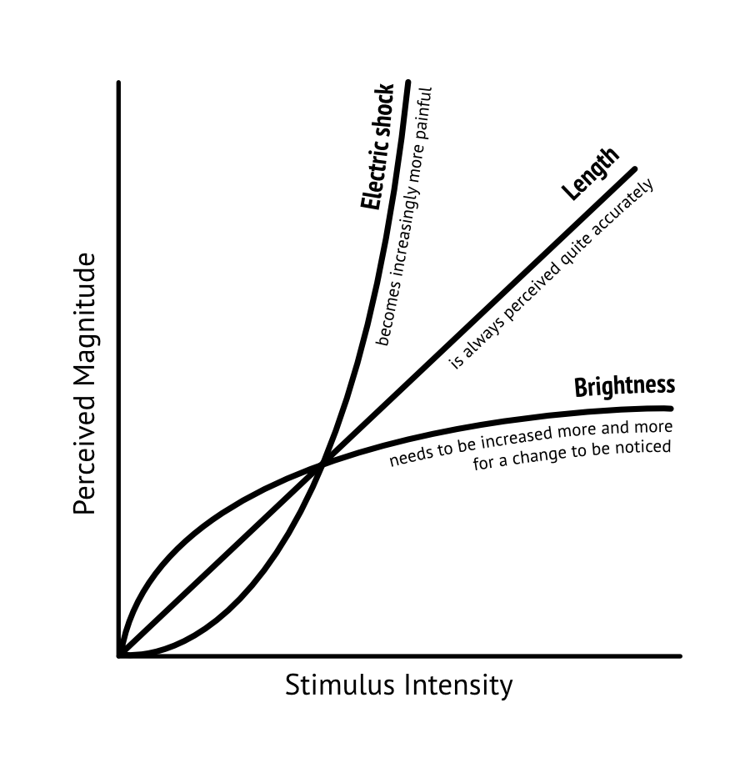
The just noticeable difference also depends on the type of stimulus and the point of comparison. This is known as Steven’s power law.
Notes:
describes how much a stimulus must be changed for it to be noticeable. This

Slide 5
Can you spot the difference now?
The circles are the same as before, but you should now be able to see that one of them is darker.
How is that possible? It is because you are getting help from a superpower of your brain: edge detection.

Slide 6
Edges make your neurons fire.
Edges are detected by specialized neurons in the primary visual cortex of your brain. These neurons care about nothing but edges and they make them “pop out”.

Slide 7
Brains love differences.
Your brain does this a lot: It detects differences quickly and automatically and brings them to your attention.

Slide 8
Naturally, there are limits to this ability and if it fails, you will have to do the work yourself.
(Can you find the black circle now?)

Slide 9
Moreover, a difference that would be obvious
….

Slide 10
when viewed
side by side ….

Slide 11
…can easily be hidden by a short gap.

Slide 12
This is called
Change Blindness

Slide 13
Repetition in Disguise
Sometimes, your brain perceives differences when there are none.
The horizontal lines in the figure on the right are equally long. Yet, the one on top looks shorter.
Illusions like this can be so persistent that you have no choice but to accept that you cannot trust your eyes.

Slide 14
Framing
is another phenomenon where two equal options are perceived to be different by your brain.
Would you buy the disinfectant that promises to kill 99% of germs?
Or the one that promises that 1% of germs survive?
Notes:
“a loss is more devastating than the equivalent gain is gratifying”
it really does make a different whether the glass is half full or half empty.

Slide 15
So here is the answer to the question
What makes
a Difference?
It is your brain.

